Slide 1
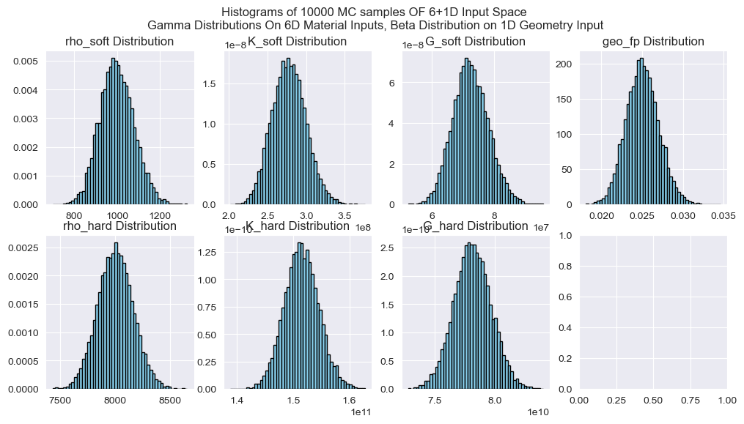
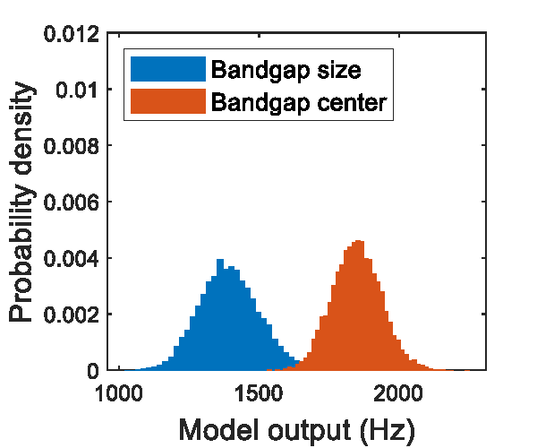
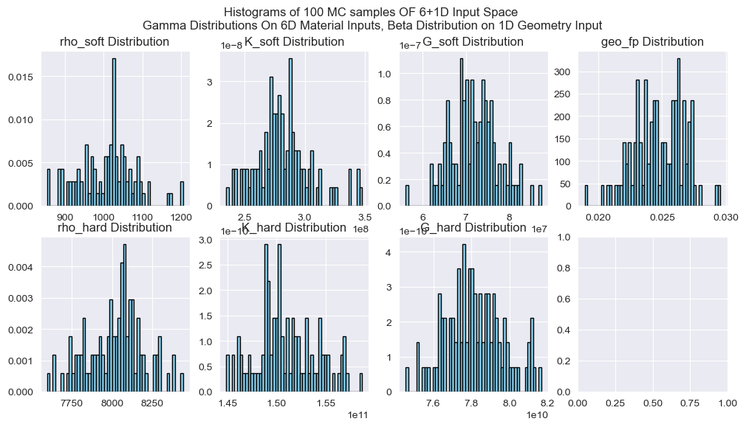
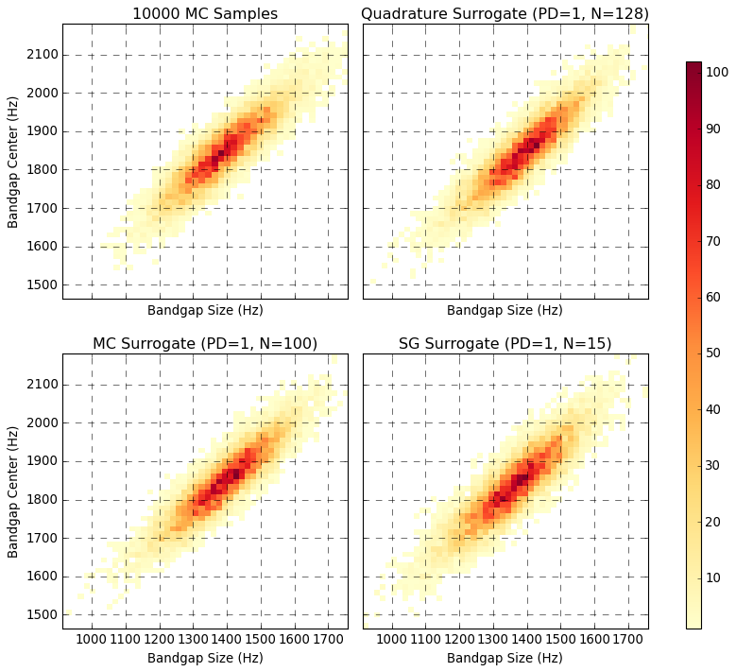
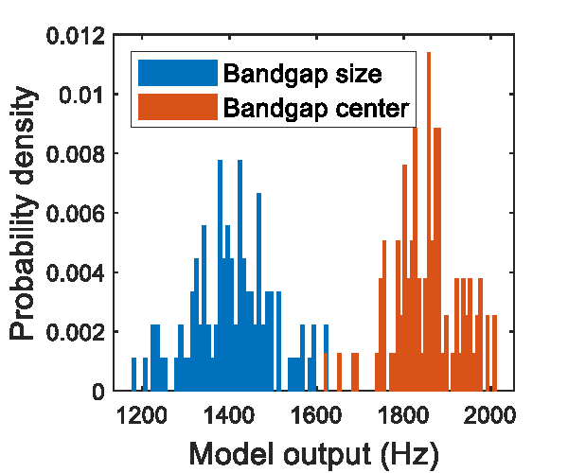
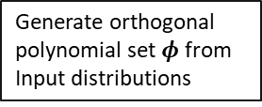


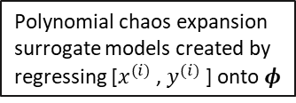
Uncertainty Quantification of Bandgaps in Acoustic Metamaterials with Stochastic Geometric Defects and Material Properties
Input Space (7D)
Sampling Strategies
10000 random samples approximates true distributions for comparison
10000 Reserved MC Samples
Geometry with stochastic defects
Monte Carlo (MC)
Quadrature Rule (QR)
Sparse Grid (SG)
Inputs
Outputs
Generate orthogonal polynomial set $φ$ from Input distributions
6 stochastic material properties
x6 (similar distributions at different scales)
Finite element solver
generates ground truth outputs from sampled inputs
Surrogate Results
Sample inputs $x^{(i)}$
Polynomial chaos expansion surrogate models created by regressing [$x^{(i)}$, $y^{(i)}$] onto $φ$
Output Space (2D)
Metamaterial bandgap size and location
Surrogate models produce surrogate samples at negligible cost. 10000 samples are produced to check model performance against true distribution
Sample Outputs $y^{(i)}$ (computed)

